Slide 1
Exploratory data Analysis & data pre-processing -
Housing Data
Padma Vasudevan

Slide 2
Agenda
Overview of the Dataset
Exploratory Data Analysis
Data Pre-Processing

Slide 3
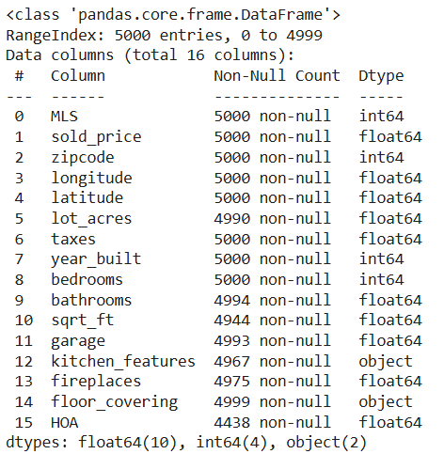
EDA – High-level Data insights
Data Dictionary
Dimension
Data types and null values
df.info()
Column Name | Description
MLS | Unique Identifier
Sold_Price | Sold price of the listing, in USD
Zipcode | Postal Code
Longitude | Geographical coordinate specifying the property’s east-west position, in decimal degrees.
Latitude | Geographical coordinate specifying the property’s north-south position, in decimal degrees.
Lot_acres | Size of the property lot, in acres.
Taxes | Annual property taxes, in USD.
Year_Built | Year when the property was constructed.
Bedrooms | Number of bedrooms in the property.
Bathrooms | Number of bathrooms in the property (may include half-baths).
Sqft | Total square footage of the property’s interior space.
Garage | Number of garage spaces available at the property.
Kitchen_Features | Description of list of features or upgrades in the kitchen.
Fireplaces | Number of fireplaces in the property.
Floor_Covering | Type of flooring materials used in the property, list.
HOA | House owner association fees, in USD
5000 x 16
Numerical Features: 14
Categorical Features: 2
Change data type from int64 to object
Highlighted cells have missing values. HOA with max missing values of 562

Slide 4
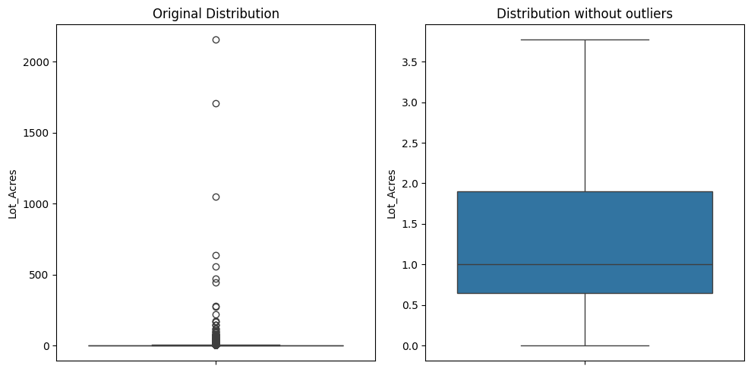
Numerical Features - Distribution
Lot_Acres
Lot_Acres is right skewed with a handful of values above 3.5 acres, extending up to 2154 acres.
Around 90% of the data is roughly normally distributed with median at 0.99 and 90th percentile value at 3.77.
Mean value is 4.66

Slide 5
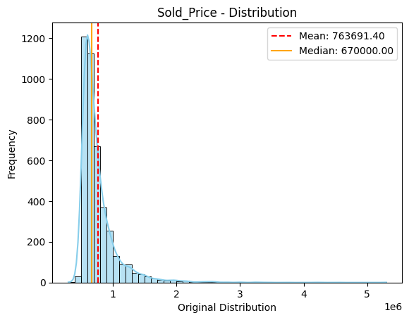
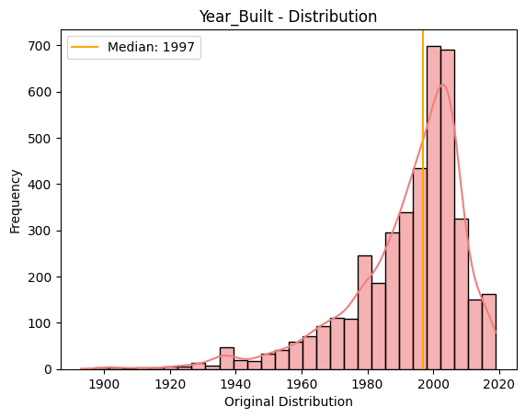
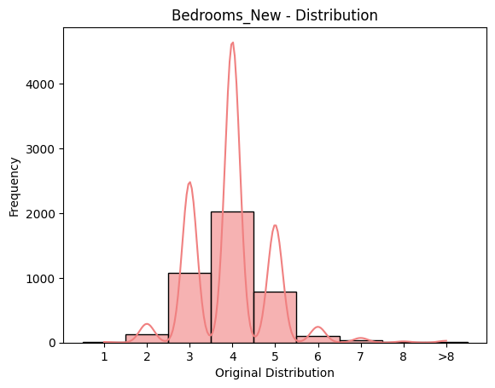
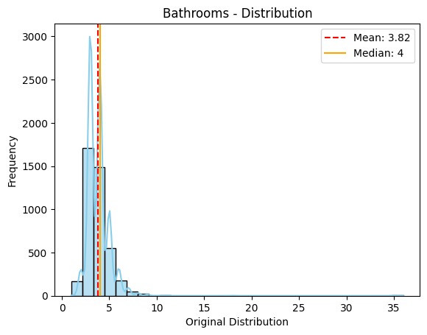
Numerical Features - Distribution
Sold_Price
99% of the properties have Sold_price between 169000 and 2M USD.
Max. value is 5.3M USD.
Year_Built
There were 5 records with 0 value.
Omitting 0 values, the distribution is left-skewed, with median value of 1997.
Max. value is 2019.
Bedrooms_New
Transformed variable with “>8” as value for bedrooms with value > 8.
Median & Mode = 4.
Max. value is 36.
Bathrooms
99% of the values are between 1 and 7.
Median is 4.
Max. value is 36.

Slide 6
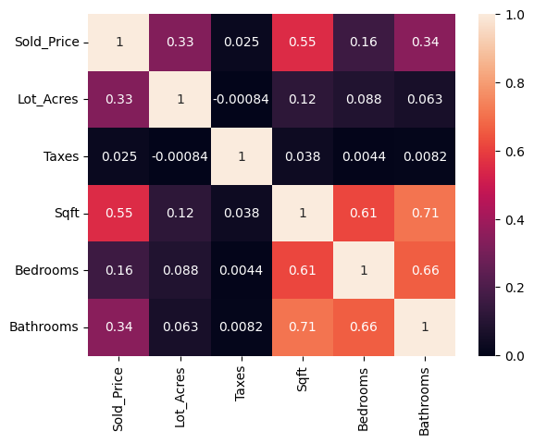
Numerical Features - Correlation
Looking at Pairwise Correlation, we see that Sold_Price is highly correlated with Sqft.
Sold_price is moderately correlated with Bathrooms and Lot_Acres.
Taxes do not correlate with any other numerical feature.
Sqft is highly correlated with Bathrooms and Bedrooms as can be expected.

Slide 7
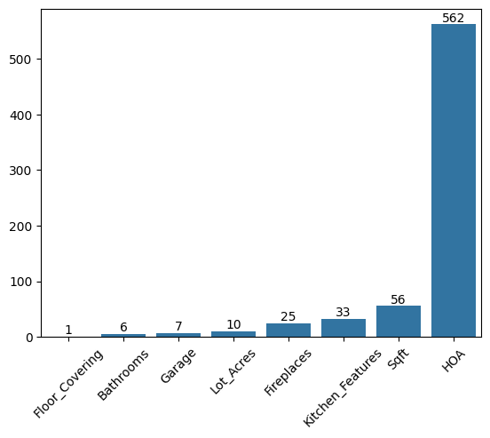
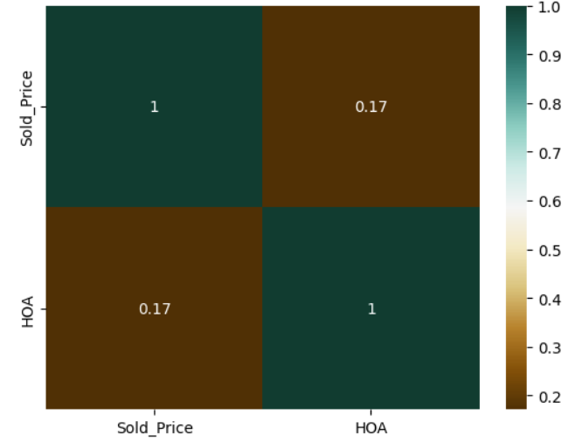
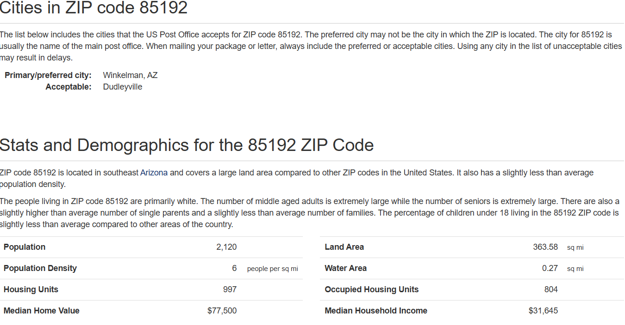
Data Preprocessing – handling Missing value
HOA
HOA has >10% missing values.
To check if it is a significant attribute, its correlation with Sold_Price was measured, which is 0.17 (very mild correlation).
To assess if zipcode-based imputation approach would be reasonable for replacing missing HOA, US zipcodes were reviewed in an online Zip repository. Each zipcode has 1000s of residential units, and are >100 sq.miles in area, as shown below.
Hence, HOA has been removed from the dataframe due to large missing values.

Slide 8
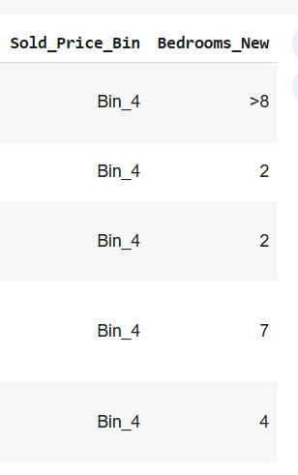
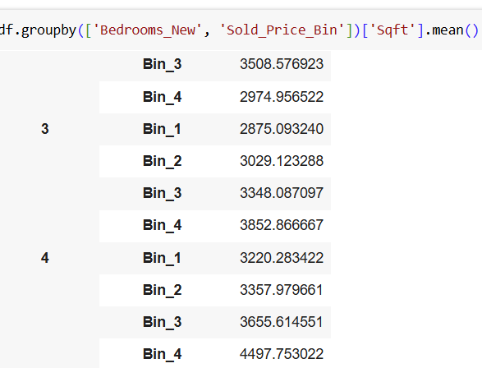
Data Preprocessing – handling Missing value
Sqft
Calculated the mean Sqft value for each combination of Bedrooms_New and Sold_Price_Bin.
Transformed features:
Sold_Price_Bin
Bedrooms_New
Sqft has >1% of missing values [56 records].
To impute for these missing values, 2 new features were created:
Sold_Price_Bin: Categorical feature for Sold_Price consisting of 4 equal Bins for the price range
Bedrooms_New: Based on distribution, values >8 were grouped into a class called ‘>8’.
For a missing value in Sqft, based on which Bedrooms_New value and price bin, the mean Sqft is imputed.

Slide 9
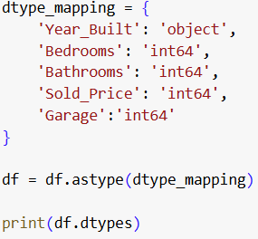
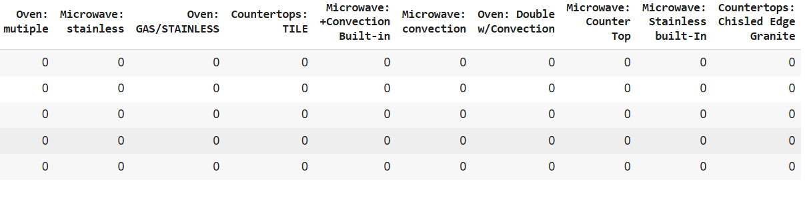
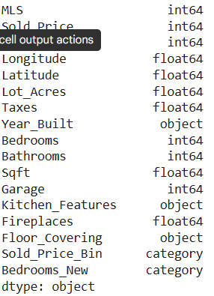
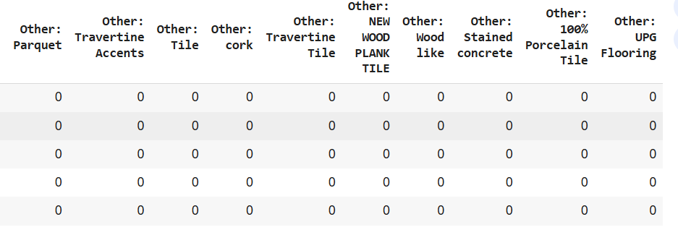
Handling Data Types
One-hot encoding for Kitchen_Features and Floor_Covering

Slide 10
Next Steps
To analyse 0 values in Lot_Acres and Year_Built and understand data quality issue.
Devise suitable approach for imputation of the above 0 values.
Some City and State values are showing as None. Need to assess reason, and update zipcode package.
City-based analysis; groupby city and find count, avg(sold_price), etc.

Slide 11
THANK YOU

